Slide 1
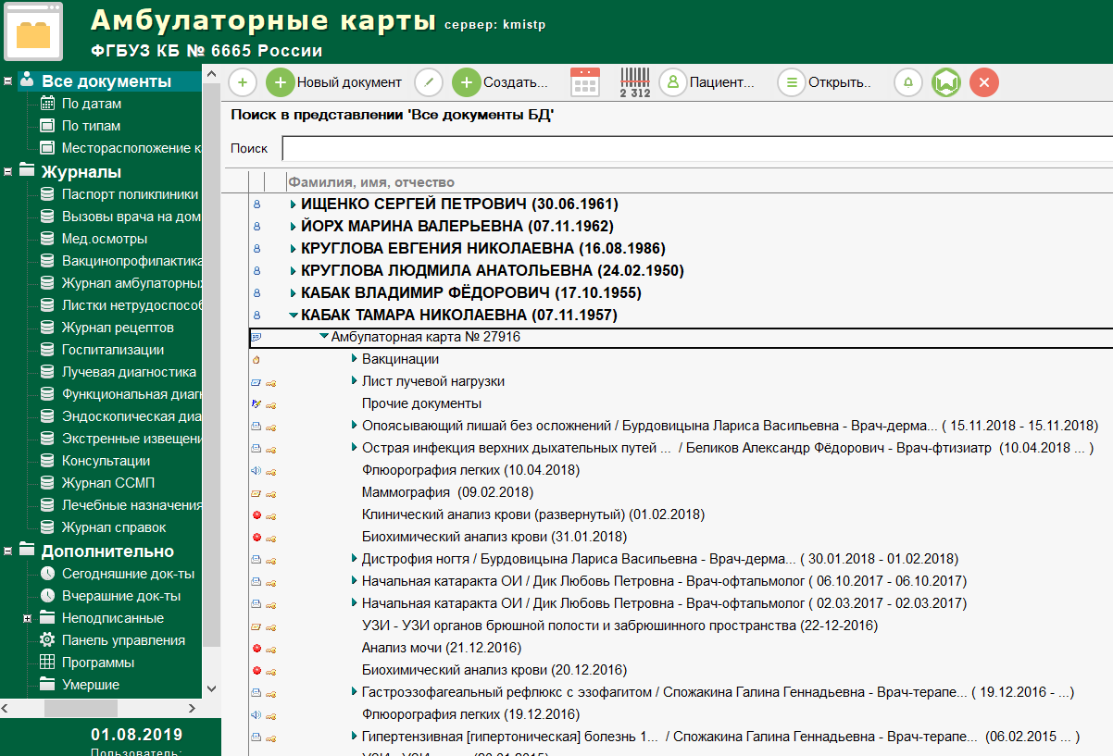
DEEP AND MACHINE LEARNING MODELS TO IMPROVE RISK PREDICTION OF CARDIOVASCULAR DISEASE USING DATA EXTRACTION FROM ELECTRONIC HEALTH RECORD
GOAL: to compare both methods to CVD risk prediction based on extracted EHR data - machine learning and traditional risk scales
I. Korsakov, A. Gusev, T. Kuznetsova, D. Gavrilov, R. Novitskiy
Russian Federation, K-Lab Ltd, Petrozavodsk State University
TECHNOLOGY
RESULTS
ELECTRONIC HEALTH
RECORD
UNSTRUCTURED DATA
NLP
DATA SET
1
0,8
АМБУЛАТОРНАЯ КАРТА № 27916
True Positive Rate
i
0,6
Deep Learning (AUROC = 0,75-0,76)
Logistic Regression (AUROC =0,74-0,76)
Framingham (AUROC = 0,62-0,72)
SCORE (AUROC = 0,66-0,73)
PROCAM (AUROC = 0,60-0,69)
31,5 ths patients
3 652 all features patients
MODEL
NEURAL NETWORKS
0,4
CLINICAL DECISION
SUPPORT SYSTEM (CDSS)
0,2
0
Individual risks
prediction
0,2
0,4
0,6
0,8
1
False Positive Rate
CONCLUSION
PATIENT COHORT
Total – 3 652 (have all features: vital signs ,diagnoses, medications)
Mean age – 49,4 (21-75)
Female - 68,2%
The machine learning models outperformed a traditional clinically-used predictive model for CVD risk prediction.
This approach was used to create a CDSS. It uses both methods: traditional risk scales and models based on neural network. The system can calculate the CVD risks automatically and recalculate immediately after adding new information to the EHR.

